Slide 1
Map and Aggregation Visualization on global soil microbial biomass data.
Prepared by:

Slide 2
Description of Dataset
The dataset we are choosing for this dataset is suitable for the purpose of our project in a sense it contains global data with spatial informations for each sample.
This data set provides the concentrations of soil microbial biomass carbon (C), nitrogen (N) and phosphorus (P), soil organic carbon, total nitrogen, and total phosphorus at biome and global scales. The data were compiled from a comprehensive survey of publications from the late 1970s to 2012 and include 3,422 data points from 315 papers.
Source: https://daac.ornl.gov/cgi-bin/dsviewer.pl?ds_id=1264

Slide 3
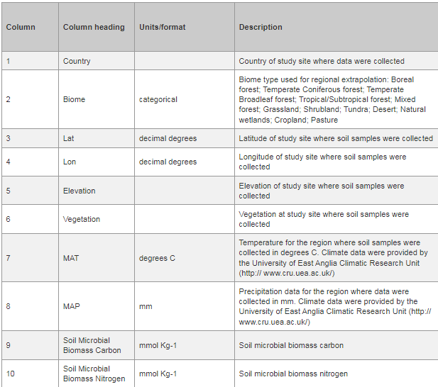
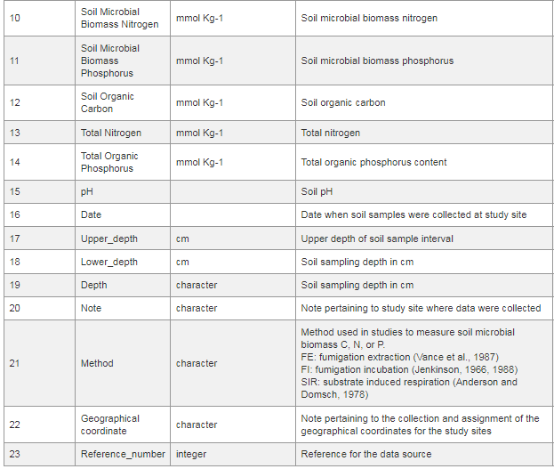
Original dataset contains 23 columns and 3424 entries. We will only use selected columns that will be most useful for our purpose and filter out the least significant entries. Image source : https://daac.ornl.gov/SOILS/guides/Global_Microbial_Biomass_C_N_P.html#datacharact

Slide 4
Project Objectives
In this project, we aim to perform exploratory data analysis on the dataset(described in previous slide) to gain insights on the spatial relations of the soil quality(carbon, nitrogen and phosphorus content) and type(biome category) with respect to environmental factors like(temperature).
Our specific objectives:
To visualize the pH of soil globally in choropleth map.
To visualize biome distribution across the globe using bubble map.
To visualize the relation between other variables using aggregative visualization tools.
To generative interactive visualizations .

Slide 5
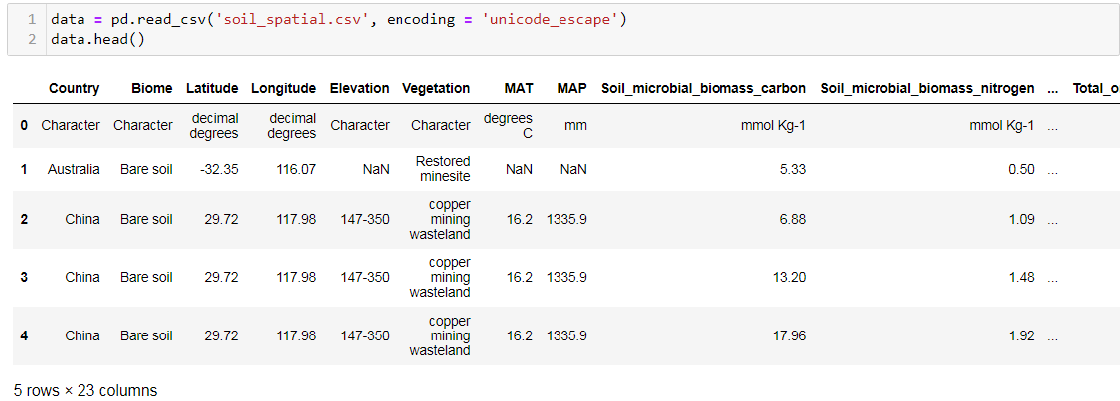
Data Loading and Cleaning

Slide 6
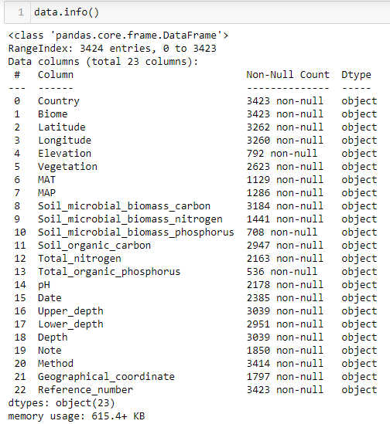
Observations:
There are a lot of missing values.
A lot of attributes can be neglected and a smaller subset of dataset can be taken for visualization.
Column names are not obviously meaningful, so that needs small changes for convenience.
All attributes are of object type, we need to convert a few of them into float for proper visualization.

Slide 7
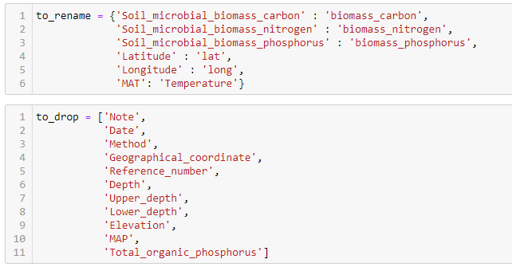
Data Cleaning and Preparation
Some columns are renamed and a bunch of attributes are dropped to select a subset of original dataset.
A lot of dropped columns were less useful and others were difficult to convert to float and also were not consistent or contained a lot of null values.

Slide 8
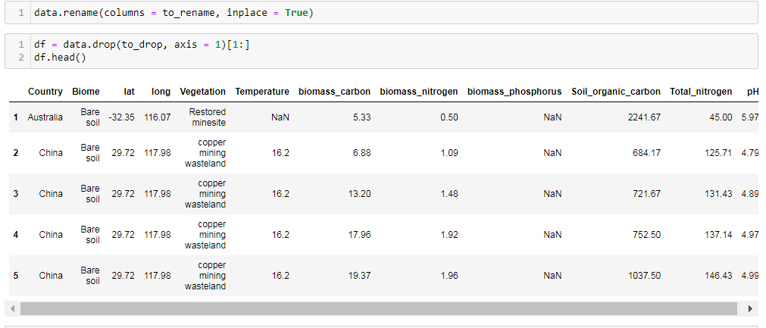
Cleaning operations:

Slide 9
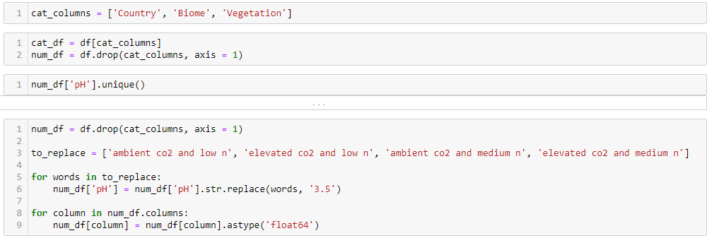
Conversion of necessary object type columns into float.
pH column contained few values in words , those were removed and remaining number strings were converted into float.

Slide 10
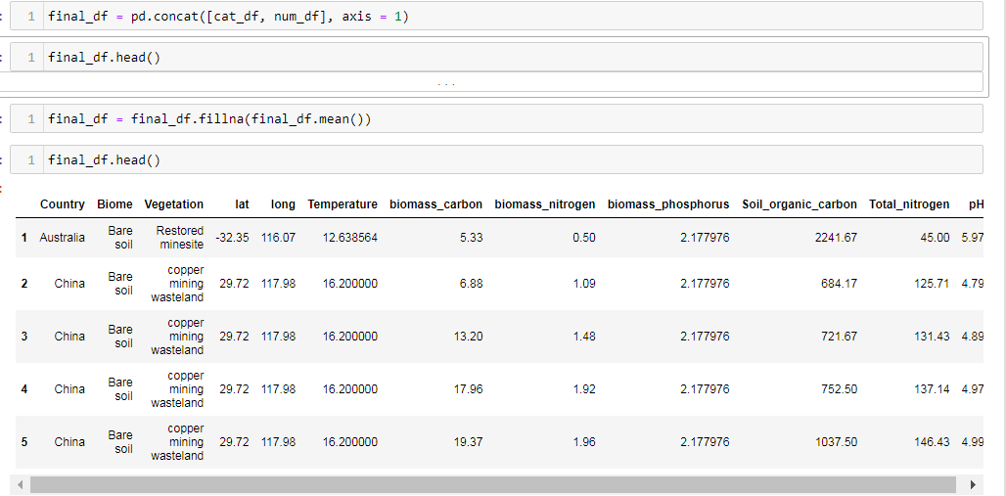
Null values were replaced by average values in the column and final clean dataset was obtained.

Slide 11
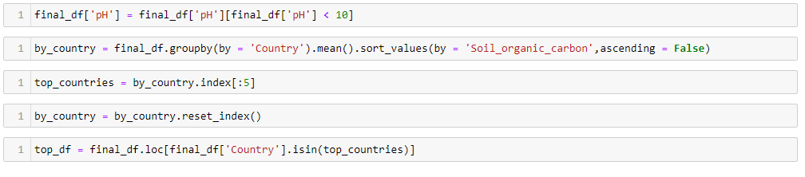
Outliers in pH column were removed.
Dataset was grouped by country and top 5 countries was selected based on ‘Soil_organic_carbon’ value.

Slide 12
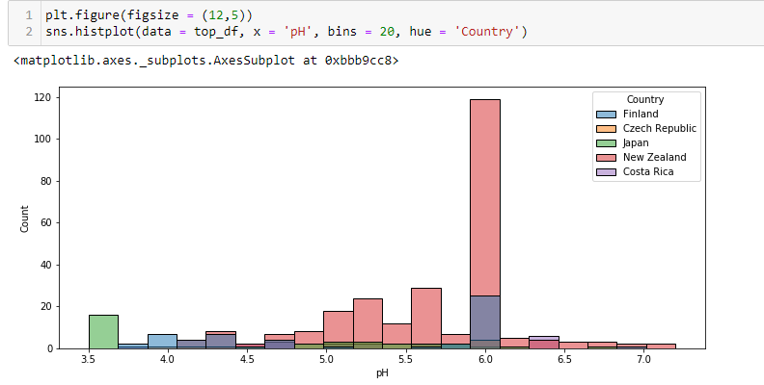
Aggregation Visualization
Histogram of pH value of soil .
Most entries in the dataset had pH value of 6.0
New Zealand had most places with pH 6.0 among top 5 countries.

Slide 13
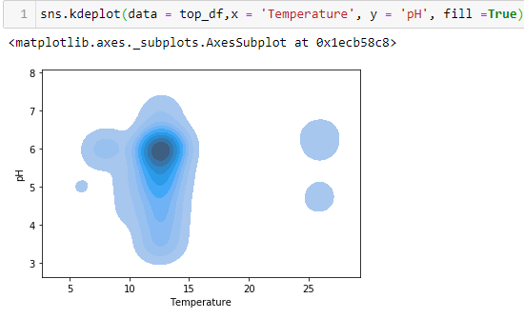
Continuous scatterplot of ‘Temperature’ vs ‘pH’
Most regions had temperature between 10 to 15 degrees with pH near to 6.0 .

Slide 14
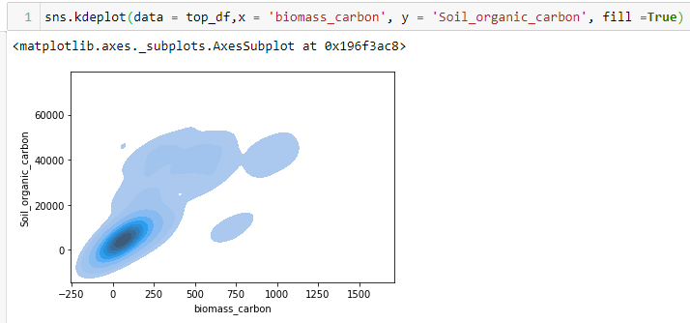
Continuous scatterplot of ‘biomass_carbon’ vs ‘soil_organic_carbon’

Slide 15
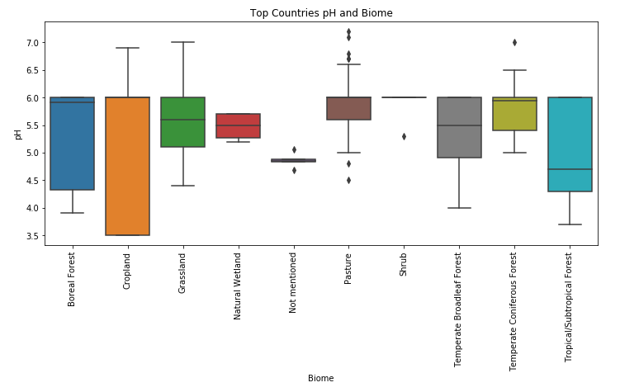

Slide 16
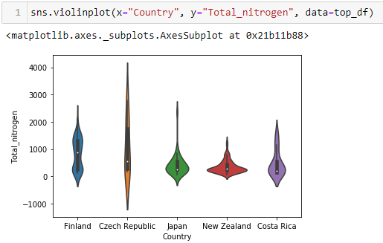
Violin Plot of ‘Total_nitrogen’ value w.r.t. top countries.

Slide 17
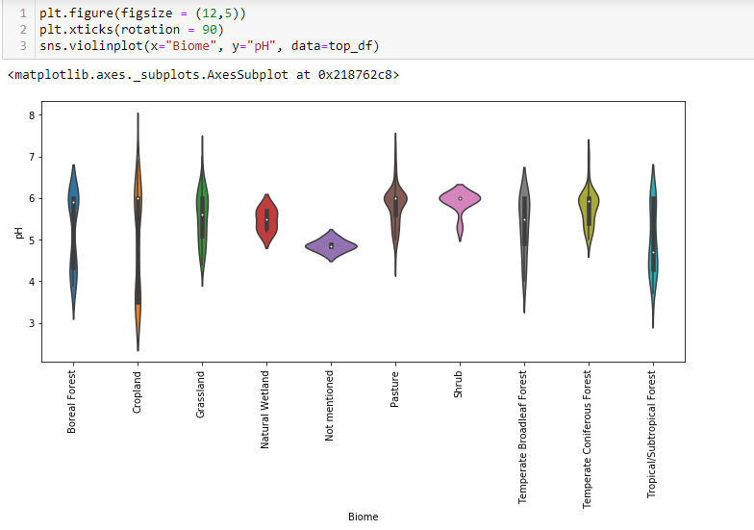
Variation of pH with respect to different biome types.

Slide 18
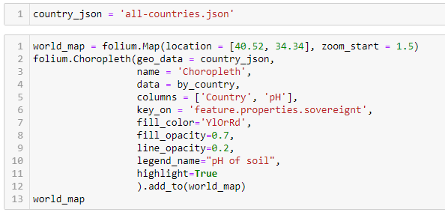
Map Visualization
This will show variation of pH across the globe for each country.
Black regions in map indicate the lack of data for those regions.

Slide 19
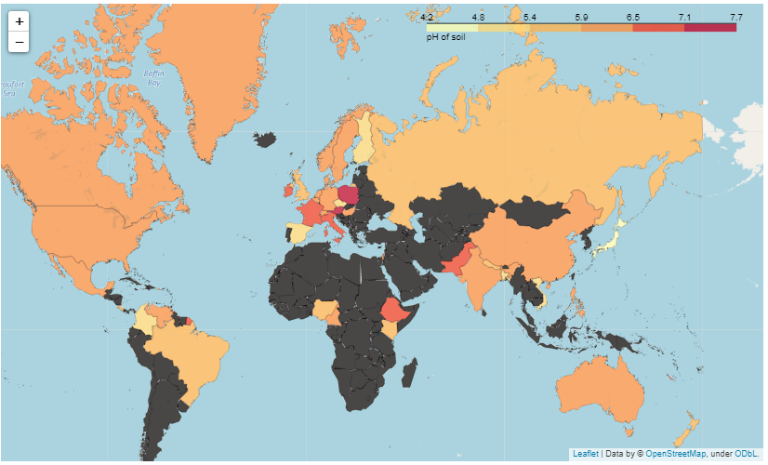

Slide 20
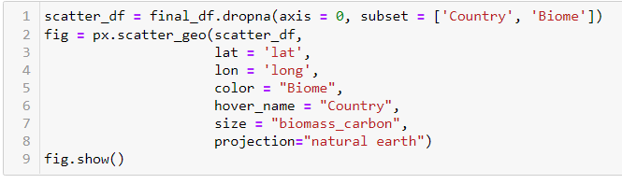
Bubble Map
This map will show the spread of Biome types across the globe.
Size of each bubble indicates the concentration of biomass carbon in soil of that place.

Slide 21
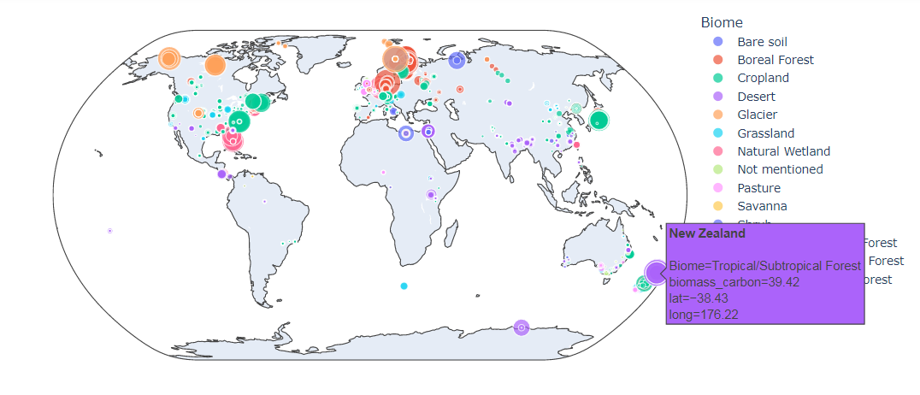

Slide 22
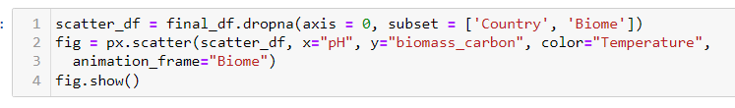
Interactive Visualization
Interactive Scatterplot
It allows user to see the scatterplot of ‘pH’ vs ‘biomass_carbon’ for any biome type.
Biome type can be changed by sliding the slider.
Colour represent different temperature.

Slide 23
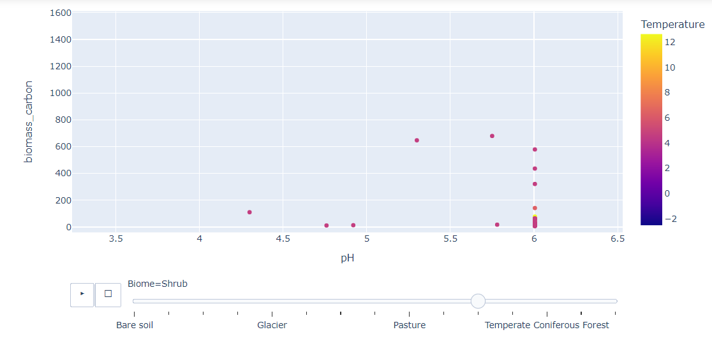
Selected Biome type: Shrub

Slide 24
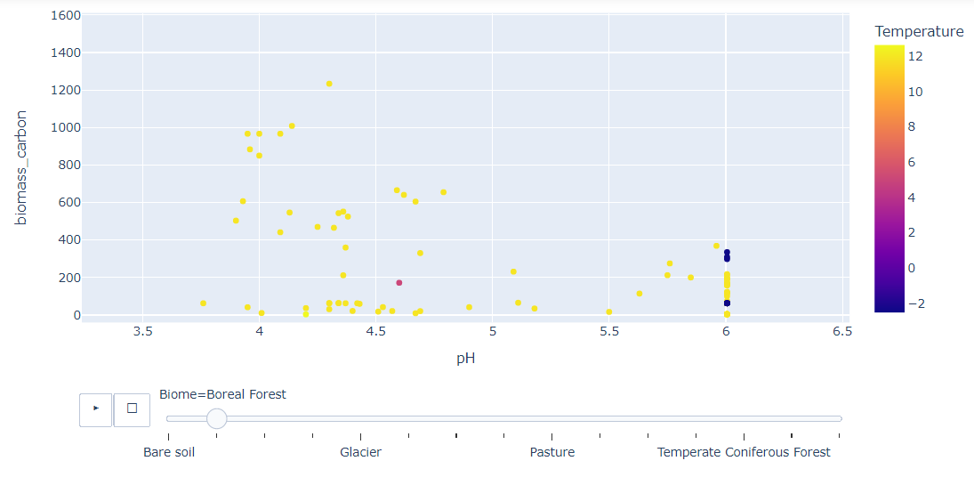
Selected biome type: Boreal Forest

Slide 25
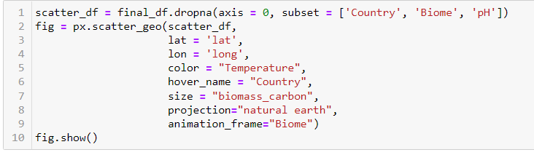
Interactive Bubble Map
It allows to observe biomass concentration in real world map for selected biome type.
Different colour represent different temperatures.
Size of bubble represents biomass_carbon_concentration.

Slide 26
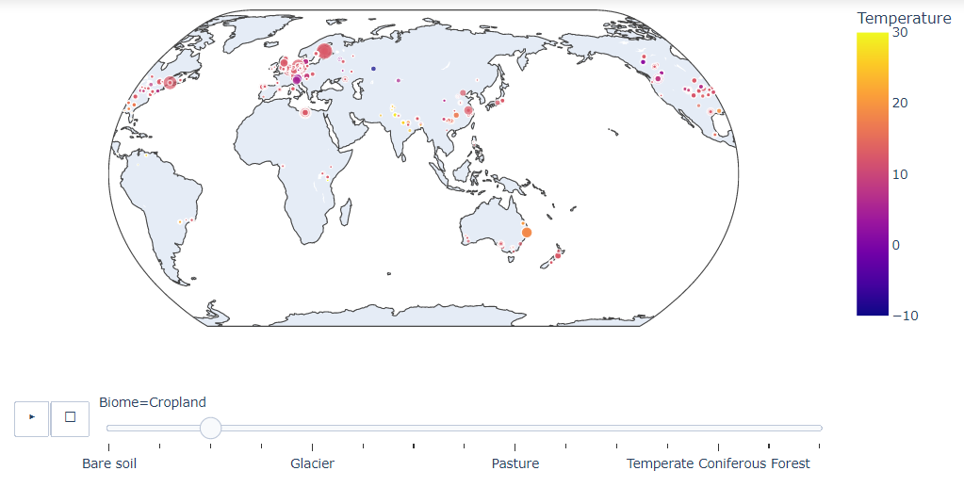
Selected Biome type: Croplpand

Slide 27
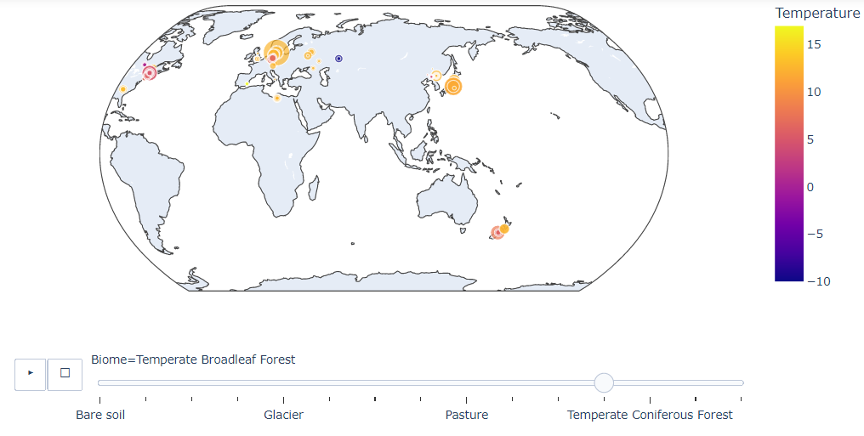
Selected biome type: Broadleaf Forest

Slide 28
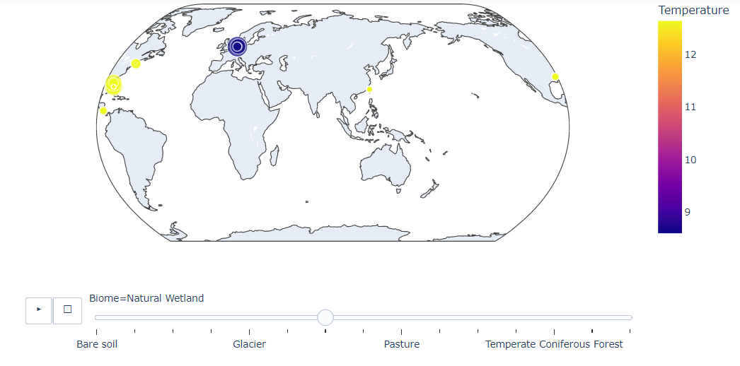
Selected biome type: Natural Wetland

Slide 29
Conclusions
We concluded that techniques such as aggregation visualization, map visualization, and interactive visualization are very useful in delivering data insights in much efficient way. Tools such as pandas, matplotlib, folium, plotly were very robust and easier to prepare seemingly complex visualizations.
Regarding the dataset, we conclude that soil biomass characteristics are very widespread and can vary from region to region. We see that even for same temperature, there was difference in biome type and carbon and nitrogen concentrations.

